Slide 1
FCC Scraper

Slide 2
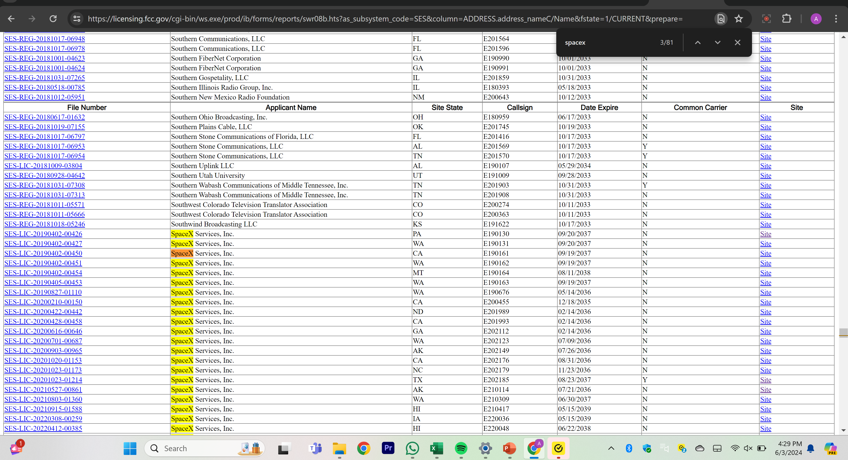
Main Page
Link to FCC Page

Slide 3
Main Page

Slide 4
Navigating to License/Registration Site
Link to License for Site - area highlighted in red above

Slide 5
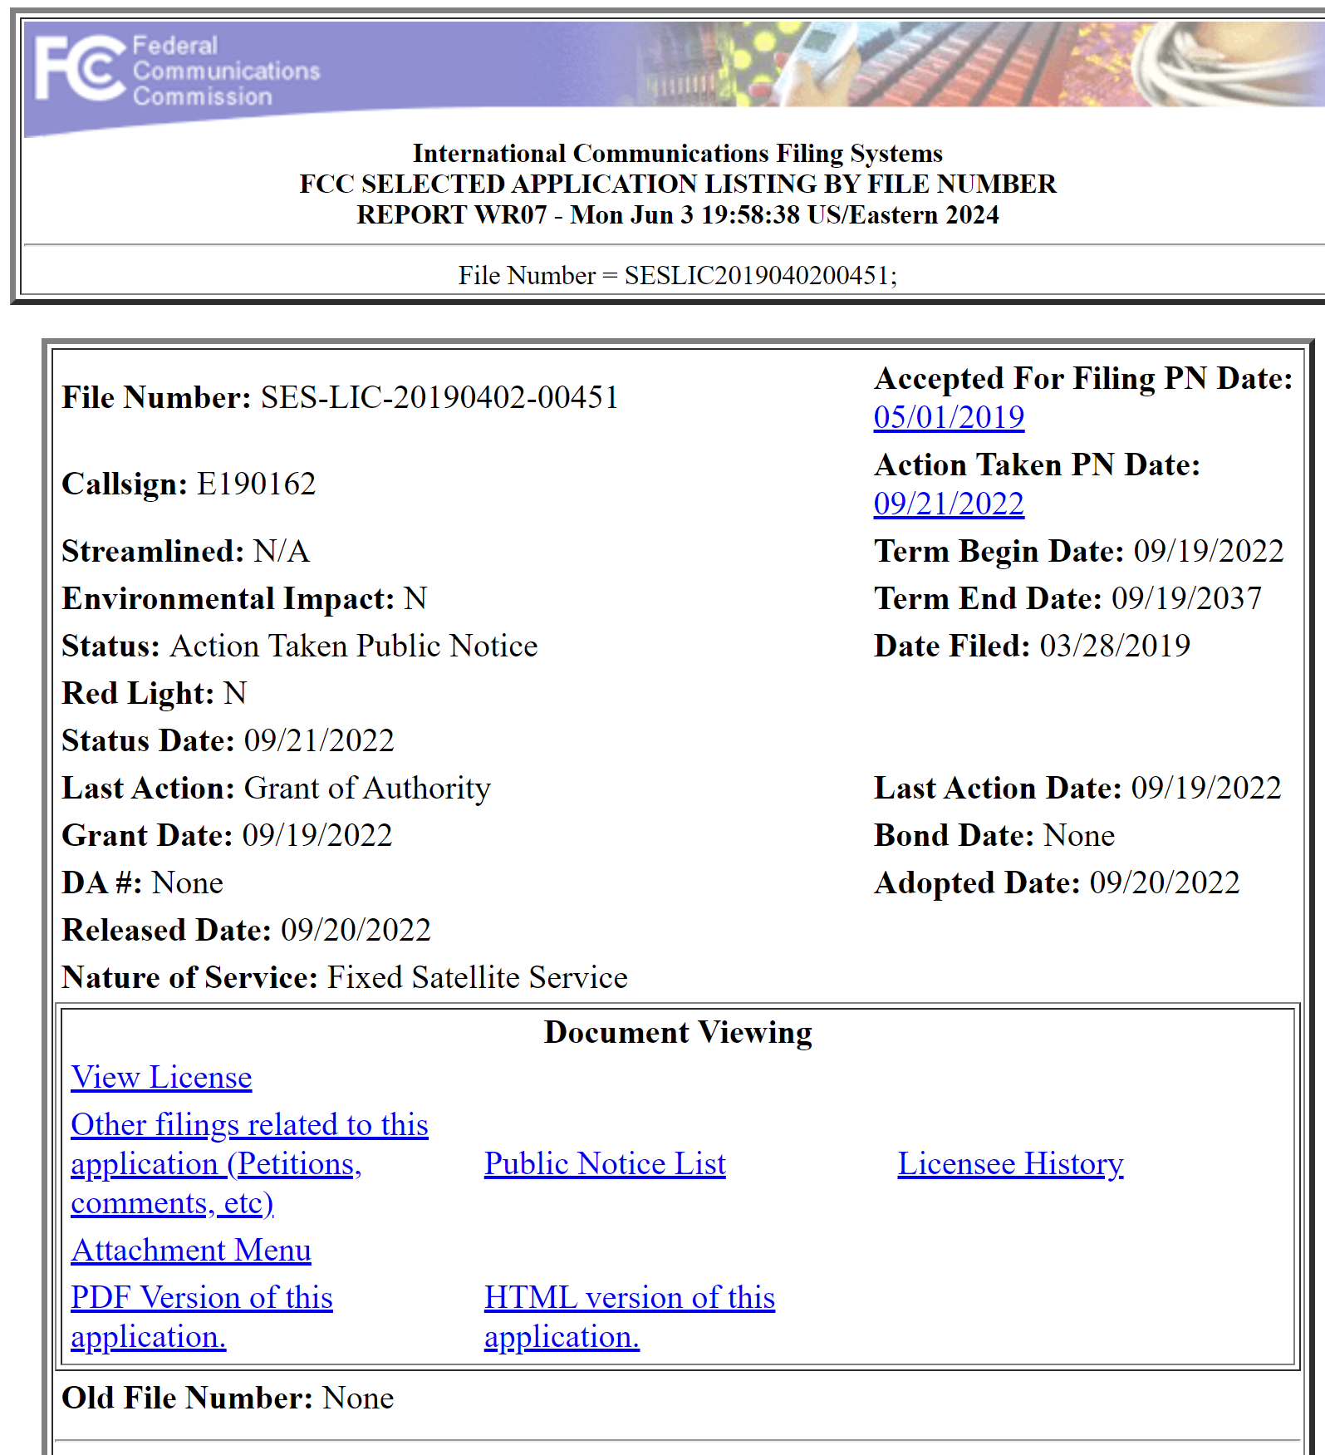
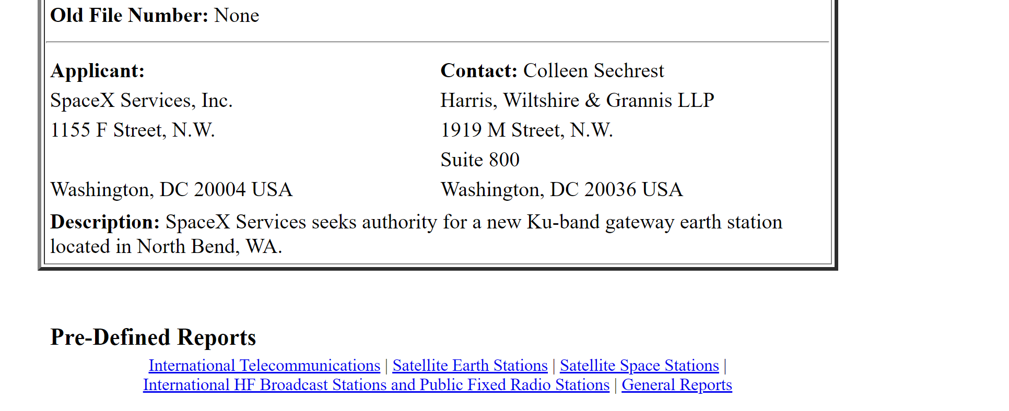
License/Registration Site

Slide 6
License/Registration Site

Slide 7
Navigating to Site Info Page
Link Info Site - area highlighted in red above

Slide 8
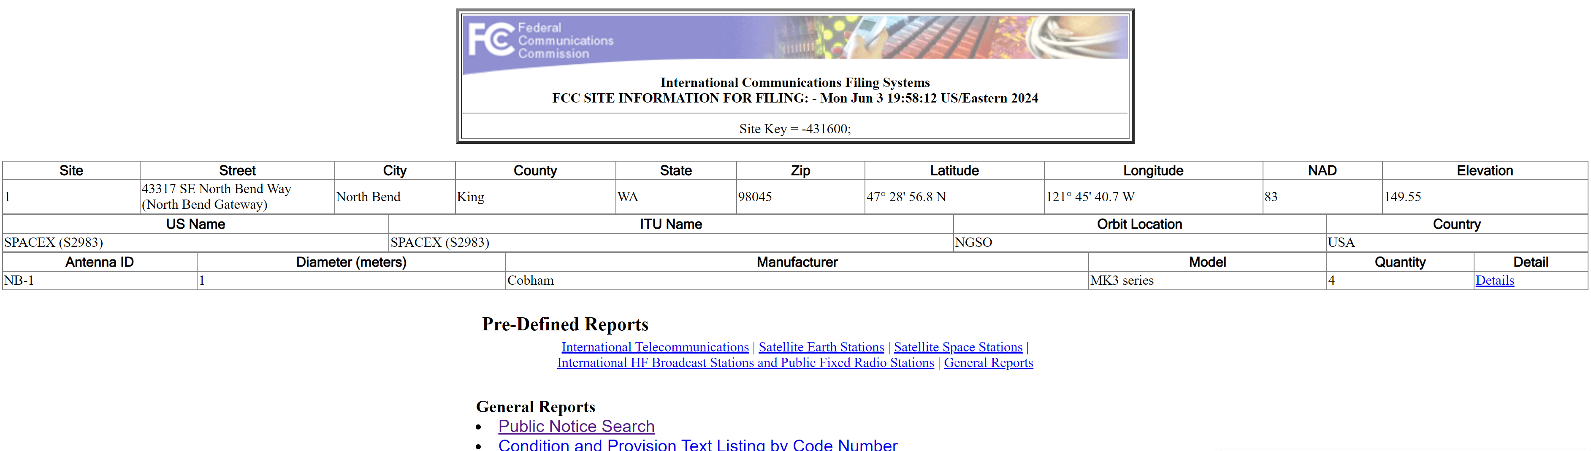
Site Information

Slide 9
Site Information

Slide 10
Navigating to Detailed Site Information
Link to License for Site - area highlighted in red above

Slide 11
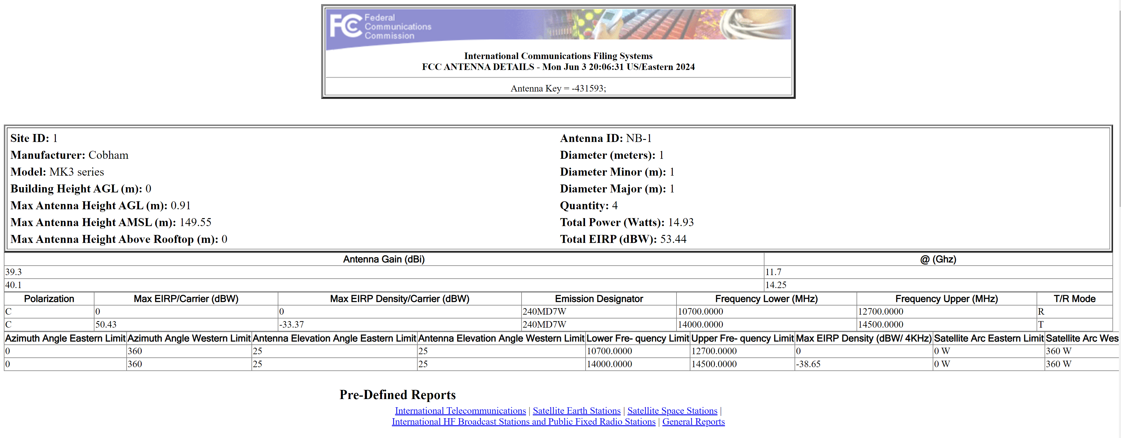
Detailed Site Information

Slide 12
Detailed Site Information

